Slide 1

Module 7.4 – Parallel Computation Patterns (Histogram)
Atomic Operation Performance

Slide 2
Objective
To learn about the main performance considerations of atomic operations
Latency and throughput of atomic operations
Atomic operations on global memory
Atomic operations on shared L2 cache
Atomic operations on shared memory

Slide 3
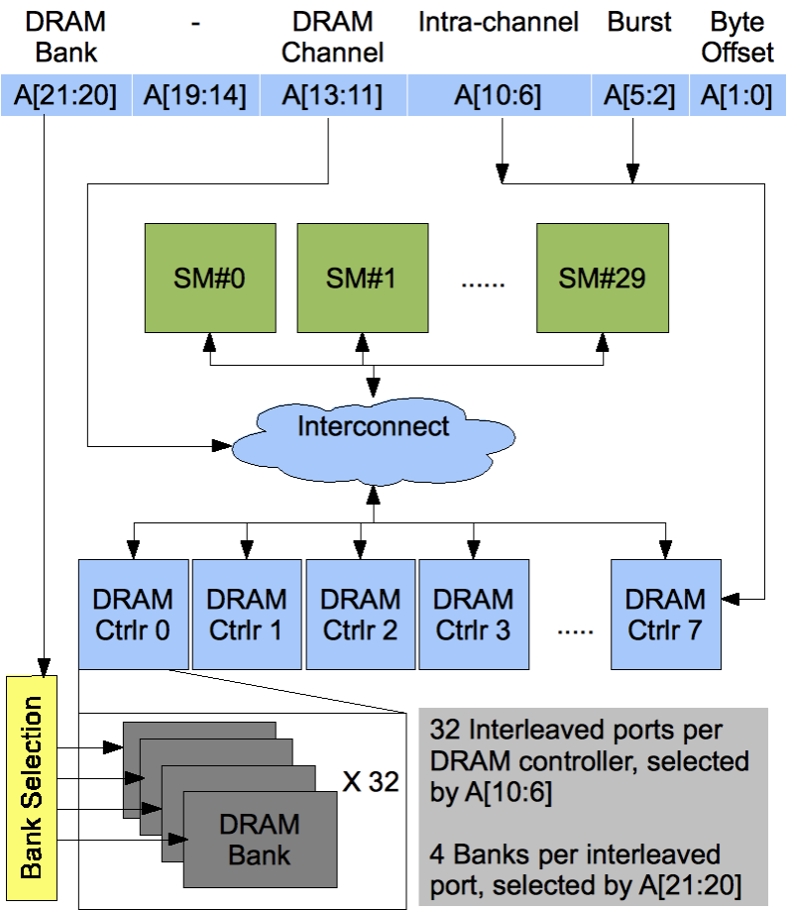
Atomic Operations on Global Memory (DRAM)
An atomic operation on a DRAM location starts with a read, which has a latency of a few hundred cycles
The atomic operation ends with a write to the same location, with a latency of a few hundred cycles
During this whole time, no one else can access the location

Slide 4
Atomic Operations on DRAM
Each Read-Modify-Write has two full memory access delays
All atomic operations on the same variable (DRAM location) are serialized
time
DRAM read latency
DRAM write latency
DRAM read latency
DRAM write latency
atomic operation N
atomic operation N+1

Slide 5
Latency determines throughput
Throughput of atomic operations on the same DRAM location is the rate at which the application can execute an atomic operation.
The rate for atomic operation on a particular location is limited by the total latency of the read-modify-write sequence, typically more than 1000 cycles for global memory (DRAM) locations.
This means that if many threads attempt to do atomic operation on the same location (contention), the memory throughput is reduced to < 1/1000 of the peak bandwidth of one memory channel!

Slide 6
You may have a similar experience in supermarket checkout
Some customers realize that they missed an item after they started to check out
They run to the isle and get the item while the line waits
The rate of checkout is drasticaly reduced due to the long latency of running to the isle and back.
Imagine a store where every customer starts the check out before they even fetch any of the items
The rate of the checkout will be 1 / (entire shopping time of each customer)

Slide 7
Hardware Improvements
Atomic operations on Fermi L2 cache
Medium latency, about 1/10 of the DRAM latency
Shared among all blocks
“Free improvement” on Global Memory atomics
time
L2 latency
L2 latency
L2 latency
L2 latency
atomic operation N
atomic operation N+1

Slide 8
Hardware Improvements
Atomic operations on Shared Memory
Very short latency
Private to each thread block
Need algorithm work by programmers (more later)
time
..
atomic operation N
atomic operation N+1

Slide 9

The GPU Teaching Kit is licensed by NVIDIA and the University of Illinois under the Creative Commons Attribution-NonCommercial 4.0 International License.

